Slide 1
Spam SMS detection
BY- ADITI MITTAL

Slide 2
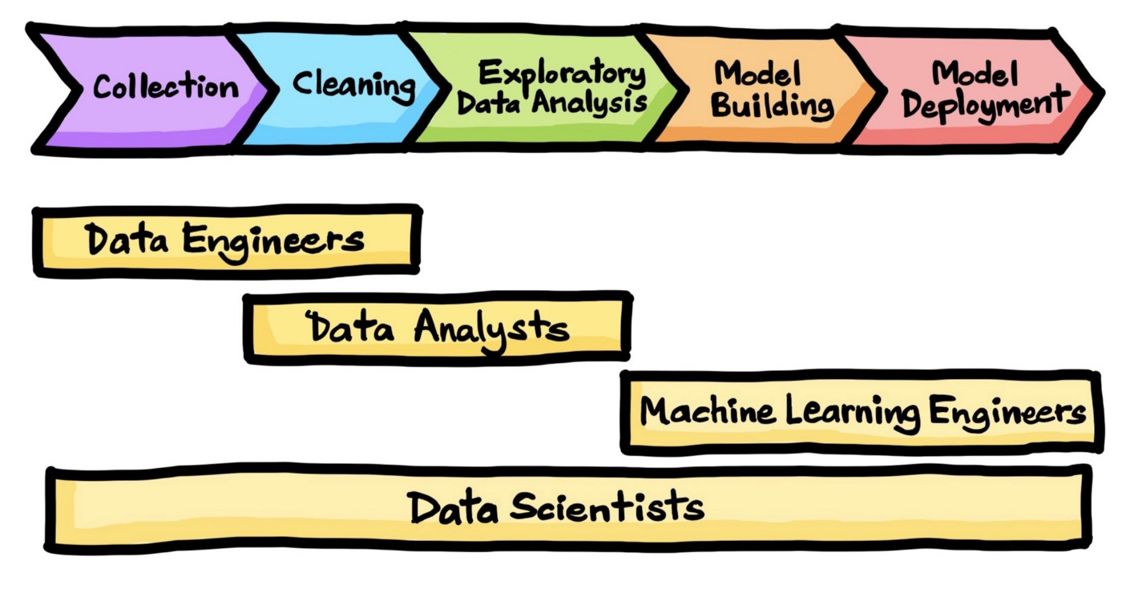

STEPS:

Slide 3
Need:
In this era, Short message service or SMS is considered one of the most powerful means of communication. As the dependence on mobile devices has drastically increased over the period of time it has led to an increased number of attacks in the form of SMS Spam.

Slide 4
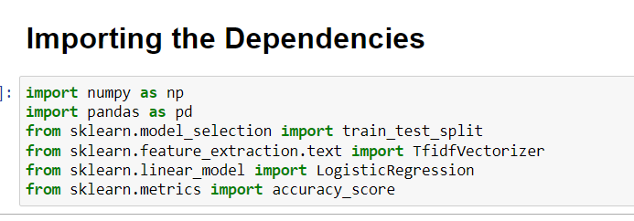
Snapshot of code

Slide 5
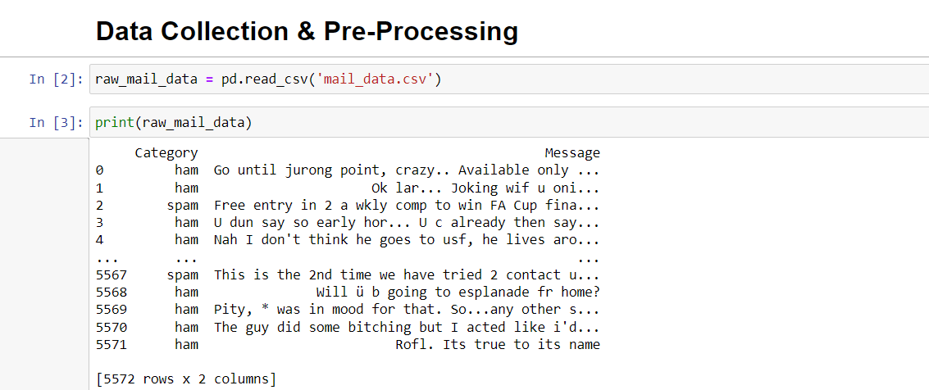

Slide 6
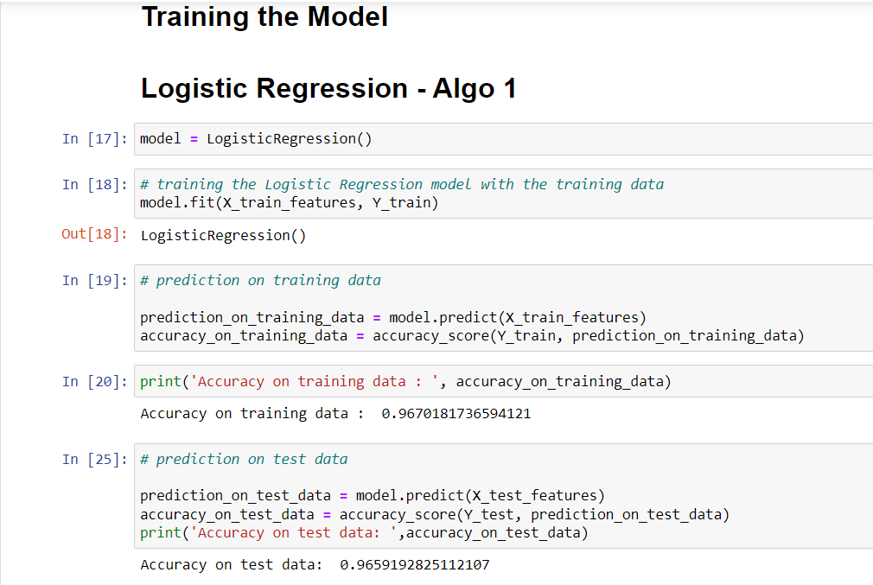

Slide 7
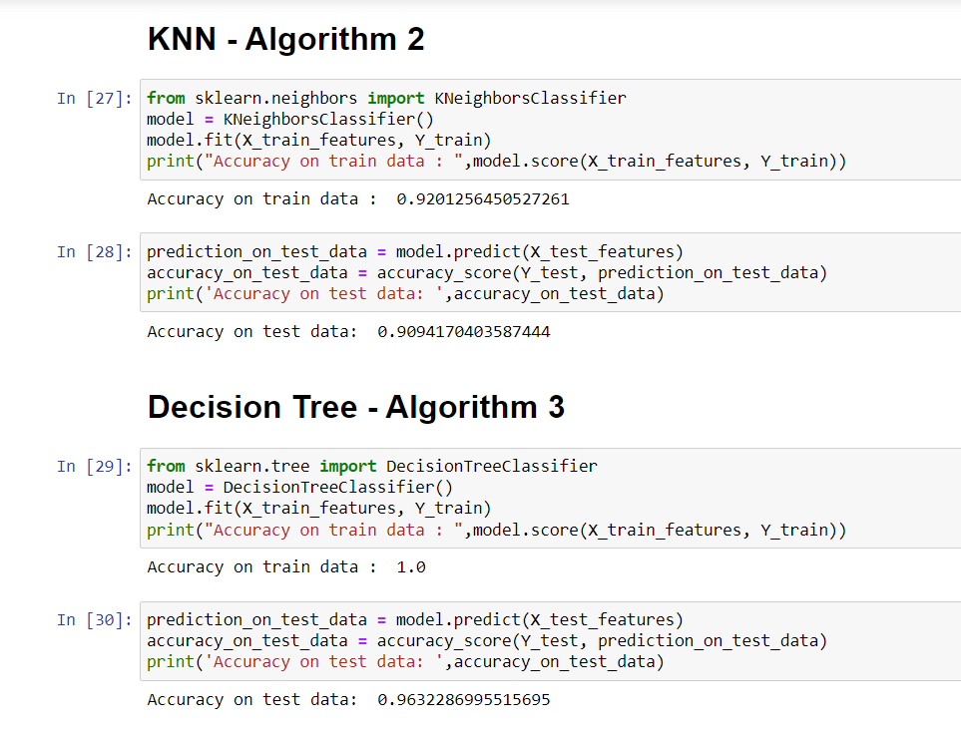

Slide 8
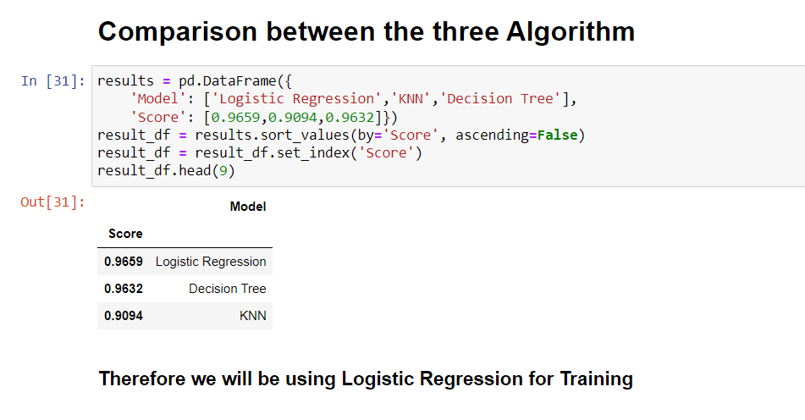

Slide 9


Thankyou

